Slide 1


Leveraging Natural Language Processing and Thematic Analysis to Understand Personal Sensing Acceptability in Opioid Use Disorder Patients
Olivia Cox
Kendra Wyant, M.S. and Dr. John Curtin
Addiction Research Center, UW-Madison
PREP Symposium 2024
Notes:
Hi, my name is Olivia Cox and this summer I worked in the Addiction Research Center with Kendra Wyant and Dr. John Curtin. Today I will be presenting on using natural language processing and thematic analysis to understand personal sensing acceptability in opioid use disorder patients.
Thanks for the introduction.

Slide 2

Opioid Use Disorder (OUD)
The chronic use of opioids for non-medical reasons that causes clinically significant distress or impairment.
In 2021, over 80,000 people in the United States died from an opioid overdose.
Very few long term supports for people in recovery.
Dydik, Jain, and Gupta 2024; NIDA 2023
Notes:
Opioid use disorder is defined as the chronic use of opioids for non-medical reasons that causes clinically significant distress or impairment.
In 2021, over 80,000 people in the United States died from an opioid overdose. To put this number in context, opioid overdoses were the 8th leading cause of death that year, right behind diabetes.
Opioid use disorder is a chronic, relapsing disease, but there are very few long term supports for people in recovery.

Slide 3

Risk Monitoring
Uses personal sensing and machine learning to predict and alert individuals of their risk of relapse.
While the potential for reaching a largely underserved population is high, it requires individuals find personal sensing acceptable.
Notes:
Risk monitoring could be a potential avenue to provide long-term support for those in recovery.
It use personal sensing, which is the collection of data using sensors in smartphones, and machine learning to predict and alert individuals that their risk of relapse is high.
While its potential for reaching a largely underserved population is high, it requires individuals to find personal sensing acceptable.

Slide 4

Acceptability of Personal Sensing
People with alcohol use disorder using sensing methods for three months found methods to be acceptable.
There are reasons to suspect this could be different among those with other substance use disorders, particularly opioid use disorder.
Very important to consider differences in race/ethnicity.
Wyant et. al, 2023
Notes:
People can comply with active sensing methods (EMA), even when using substances. Previous research has shown that individuals with alcohol use disorder using sensing methods for three months found them to be acceptable.
However, there are reasons to suspect this could be different among those with other substance use disorders, particularly opioid use disorder. Opioids are an illegal class of drug, which could make individuals fear being arrested for relapsing back to use.
Like most health and mental health conditions, treatment disparities among race/ethnic minority groups are prevalent with Opioid use disorder.

Slide 5
Aims of Study
Assess if individuals with opioid use disorder from a national sample find personal sensing methods to be acceptable.
Determine if there are differences in acceptability between different race/ethnicities.
Notes:
The aims of this study are to assess if individuals with opioid use disorder from a national sample find personal sensing methods to be acceptable and to identify if there are any differences in acceptability between different race/ethnicities.

Slide 6
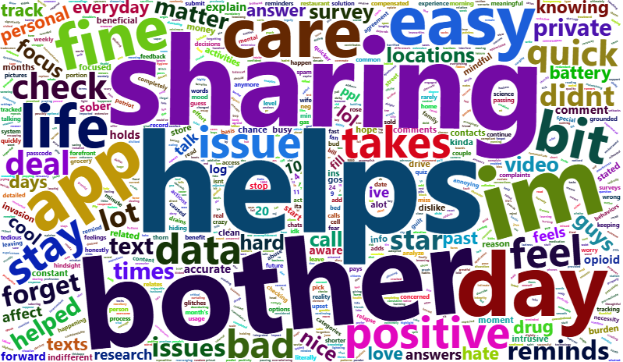
Notes:
Our study was unique in that we let participants respond openly on the survey so that we could determine their perceptions of these personal sensing methods. We used their own words to determine the themes that will inform us of the strengths, challenges, and barriers associated with these methods.

Slide 7




Procedure
“Please share any positive or negative comments you have about [Sensing Method].”
12 Months
Notes:
We recruited individuals in treatment for Opioid Use Disorder across the United States. Individuals were asked to download a digital therapeutic onto their smartphones and provide personal sensing data for up to one year. Specifically, they completed a brief daily survey, a longer monthly survey, and gave us access to sensed geolocation, SMS and phone call logs, and text message content.
Participants were asked to provide open ended feedback on their experience with each sensing method at approximately 3-4 months into the study with the prompt - “Please share any positive or negative comments you have about the Sensing Method.”

Slide 8
Study Demographics
N = 200
Age ranged from 22-65+
90% of our sample fell between 26 – 55 years old
Notes:
Our sample of participants consisted of 200 individuals from 38 states across the US.
74% were White/Caucasian, 13% were Black/African American, 6% were of Hispanic, Latin, or Spanish origin, and 7% fell into smaller groups such as Asian and American Indian.
We had an almost even split on gender and income.
The age of participants ranged between 22 – 65+, with 90% of the sample falling between 26-55 years old.
All of our participants had a lifetime diagnosis of Opioid use disorder, with 96% of our sample currently meeting criteria for severe OUD.

Slide 9
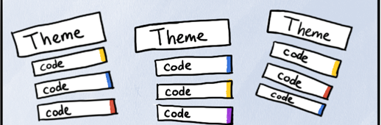
Thematic Analysis
Top-down approach
Driven by research aims and questions
Deductive codes informed by prior research
Inductive codes iteratively created
Notes:
We used two complementary analytic methods to analyze participants’ comments about the personal sensing methods.
The first method was thematic analysis. This is a systematic approach for identifying, analyzing, and reporting patterns or themes within qualitative data. It is top-down in that it uses domain expertise to create a codebook of thematic categories driven by the aims and questions of the research being conducted. As coding is underway the codebook iteratively expands to include additional themes.

Slide 10
Thematic Analysis
Total comments: 1,356
Total comments retained: 647
Report the overall percentage of comments in each theme and separately by data type.
Compare proportion of themes by race/ethnicity.
Notes:
We began with a total of 1,356 comments. The first coder went through and identified any irrelevant comments, comments that were two words or less, while coding independently.
After the excluding process, there were 647 comments in total retained and coded by both independent coders.
For the results, we’ll report on the overall percentage of comments in each them and separately by data type and also differences in proportion of themes by race/ethnicity.

Slide 11
Thematic Analysis - Themes
Theme
Comment
% of comments, (n)
Acceptability
“It’s a good tool that makes me
30.14%, (195)
look back and reflect on my
recovery.”
Usability
“I think it’s great and very precise
22.87%, (148)
about the information you ask.”
Benefits
“It helps me stay sober.”
15.76%, (102)
Trust/Privacy
“It’s a bit of an invasion of privacy
15.45%, (100)
but I understand why it’s needed
for the study.”
Sustainability
“I have worked this daily update
13.14%, (85)
into my routine.”
Notes:
From those 647 comments, we found 10 themes.
About half of the comments were feedback and others did not have many comments endorsing them.
Here are the top five themes:
Acceptability, which demonstrated participant’s willingness or unwillingness to use the personal sensing methods.
Usability, is the app easy to use and understandable?
Benefits, where participants shared if they found the app to be beneficial to their recovery.
Trust/privacy, participants could inform us if they trusted the researchers and/or if they found the methods to be invasive.
And sustainability, demonstrating if participants felt they could use these methods consistently during the study period.

Slide 12
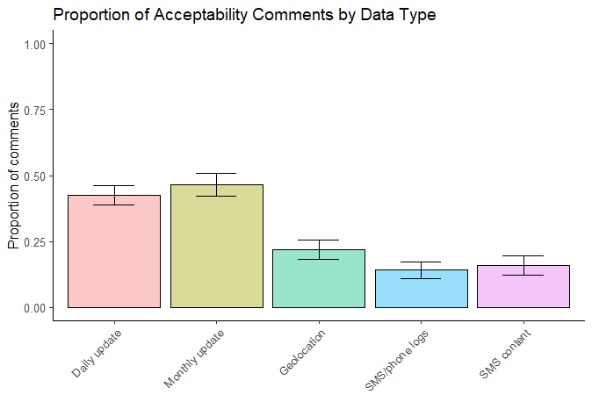
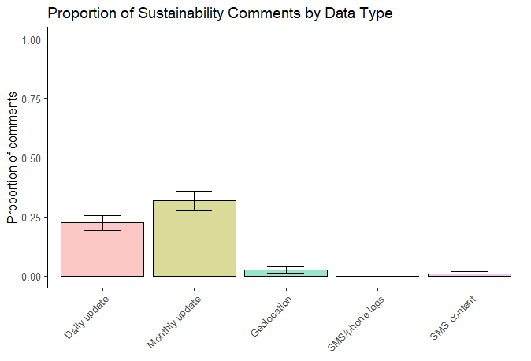
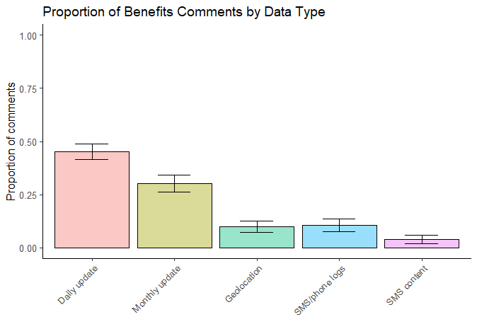
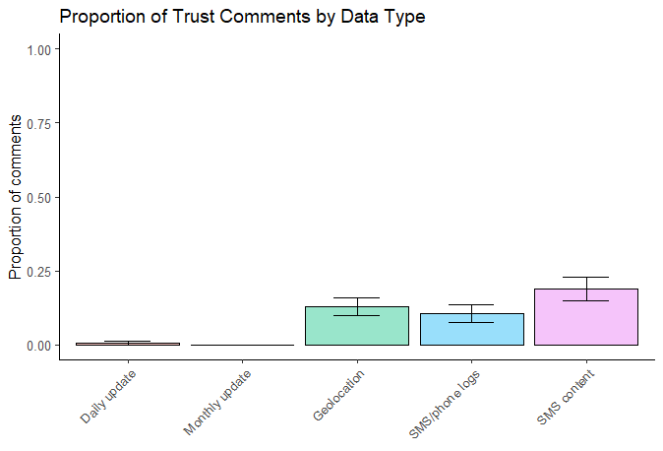
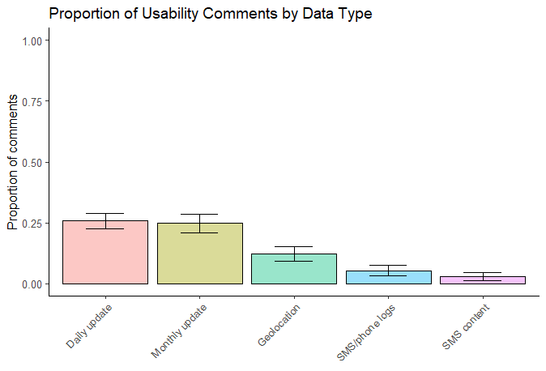
Proportion of Comments by Data Type - Themes
Notes:
Here I am showing you the proportion of comments that were coded as being included in the acceptability theme as a function of data type. On the x-axis you will see our 5 sensing methods – daily update, monthly update, geolocation, sms phone logs, and sms content.
These are the same style of plot for our other 4 themes. On the top from left to right we have sustainability and benefits and on the bottom trust and usability.

Slide 13


Notes:
Next I am going to show you how these proportions vary by data type. On the x-axis are our 5 sensing methods – daily update, monthly update, geolocation, sms phone logs, and sms content.
On the y-axis is the proportion of comments.

Slide 14
Notes:
Here is Acceptability: Participants mentioned acceptability across all measures. Whether it was them saying they liked or didn’t like measures, participants contributed to us better understanding personal sensing acceptability.

Slide 15

Notes:
Sustainability played a role for the updates but not for the passive sensing measures. Participants had to make the time to complete the updates, which made sustainability important as they integrated these tasks into their routines.

Slide 16

Notes:
Benefits were more commonly noted for the updates, but not so much for the passive sensing measures. A lot of people noted that the updates played a huge role in their recovery.

Slide 17

Notes:
Trust appeared to be more important for the passive sensing measures but didn’t play a huge factor for the daily and monthly update. Participants could choose what to share for the updates, which led to it not being as much of a concern compared to the passive sensing measures which tracked everything.

Slide 18

Notes:
Usability was a factor for the daily and monthly update, but not so much for the passive sensing measures. Like sustainability, there was nothing participants had to do with the passive sensing, but they did have to navigate the updates themselves.

Slide 19
Thematic Analysis - Affect
Affect
Comment
% of comments, (n)
Positive
36.63%, (237)
“The program and daily updates
have helped my recovery and
helped me to evaluate my
emotions and actions.”
Negative
10.97%, (71)
“I just disliked how it drained the
battery on my phone so quickly.”
Neutral/mixed
“I don’t mind providing this
52.24%, (338)
information.”
Notes:
We also coded affect by positive, negative, and neutral/mixed.
Around 50% of comments were neutral/mixed but were happy to report that about 36% were positive.
Overall participants reported positively across data types.
But we did find significant differences across race/ethnicity

Slide 20
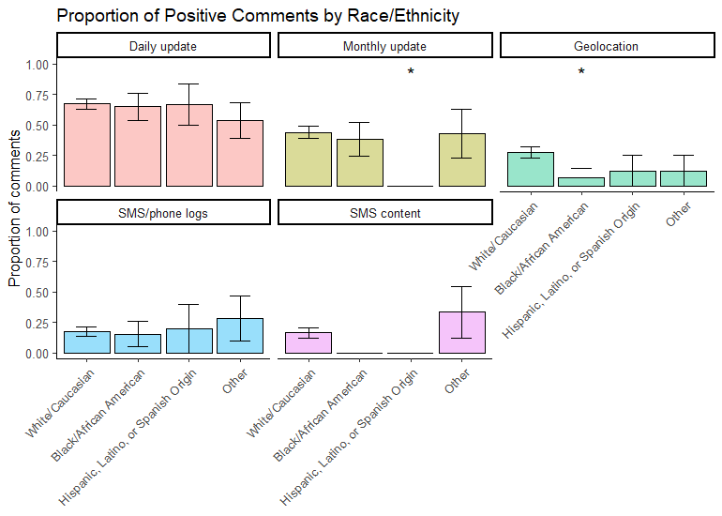
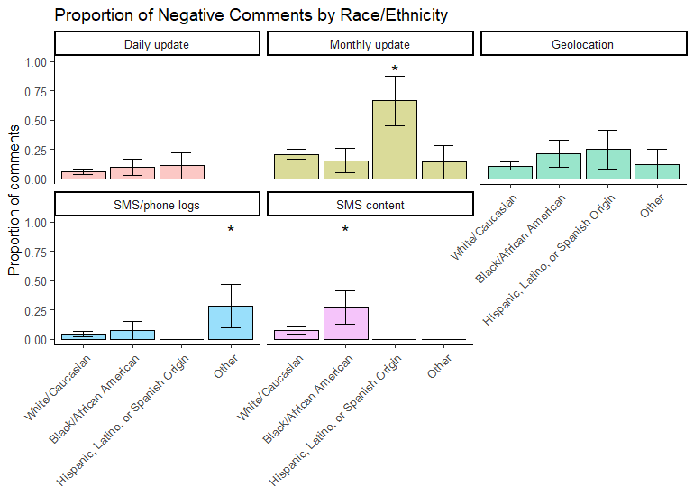
Demographic Differences in Themes - Race
Notes:
Here I am now showing you race on the x-axis and the plots are faceted by data type.
We found a significant difference in the proportion of positive and negative comments by Hispanic participants compared to White participants for the monthly update.
Positive comments were also notably less for SMS content for Black and Hispanic groups. Additionally Black participants were significantly more likely to report negative comments for about this sensing.
Finally, Black participants were significantly less likely to report positive comments about geolocation compared to white participants.

Slide 21
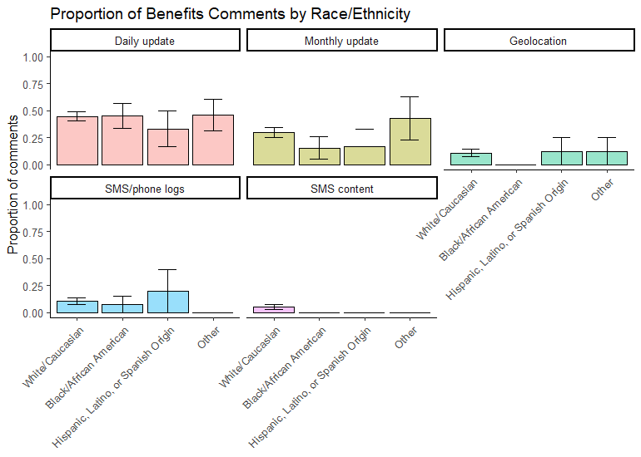
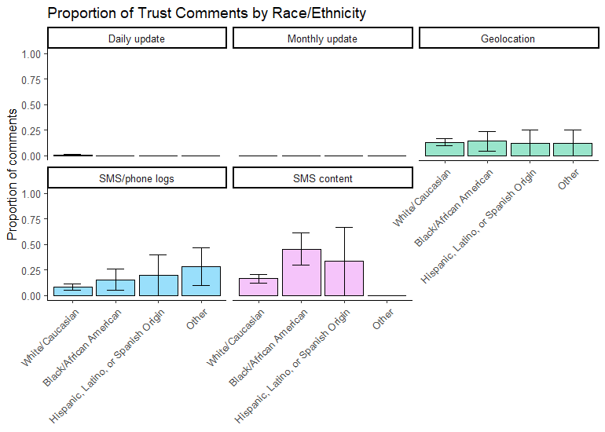
Demographic Differences in Themes - Race
Notes:
Looking at patterns of benefits and trust may help explain these differences.
Black participants reported virtually no benefits in their comments about geolocation and SMS Content, whereas for these same categories they reported higher percentages of comments that were related to trust for these sensing methods.

Slide 22
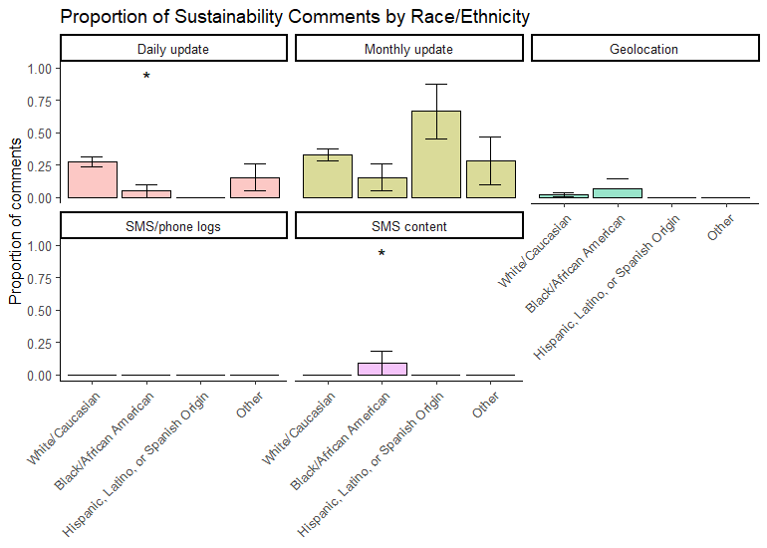
Demographic Differences in Themes - Race
Notes:
And going back to the negative comments about the monthly update in the Hispanic group. This plots on the sustainability of the methods offer additional insight. The only sensing method people in the Hispanic group made sustainability comments was about the monthly update. And these comments were much more frequent than the other groups. This suggests that perhaps the longer length of the survey or something inherent in the method was making it difficult for people in this group to complete it each month.

Slide 23
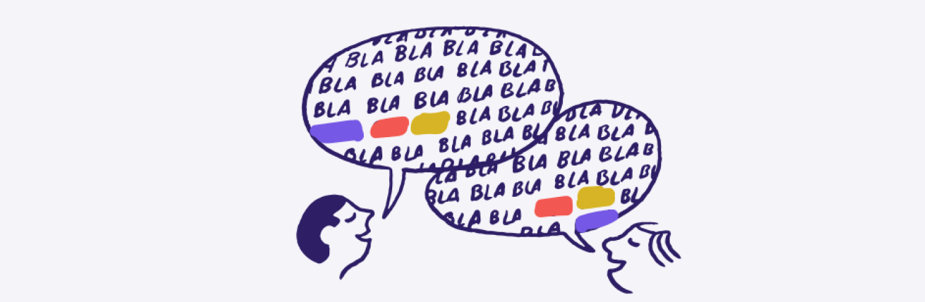
Topic Modeling
Bottom-up approach
Driven by data
Identifies clusters of words that co-occur frequently together
Allows new and unexpected categories to emerge as being important
Notes:
The second method was topic modeling. This approach uses Natural Language Processing and unsupervised machine learning methods to identify clusters of words that co-occur frequently together. It is a bottom-up approach in that thematic categories are created from the data without any top-down interference. This is a promising method, particularly when looking at demographic differences because themes we may not have thought of can emerge and inform us.

Slide 24
Structural Topic Modeling
Controlled for covariates of race and data type.
We looked at the top words defined by FREX, a metric that evaluates word frequency and exclusivity to a topic.
We found that there were 15 unique topics.
Notes:
We used Structural topic modeling. This acts differently from more traditional topic modeling approaches in that the document-level metadata can be added into the modeling process.
We used race and data type as covariates and saw how the content of the topics might shift from one group to the next.
We looked at the top words defined by FREX, a metric that evaluates word frequency and exclusivity to a topic.
We found there were 15 unique topics and 6 significantly differed by race/ethnicity.

Slide 25
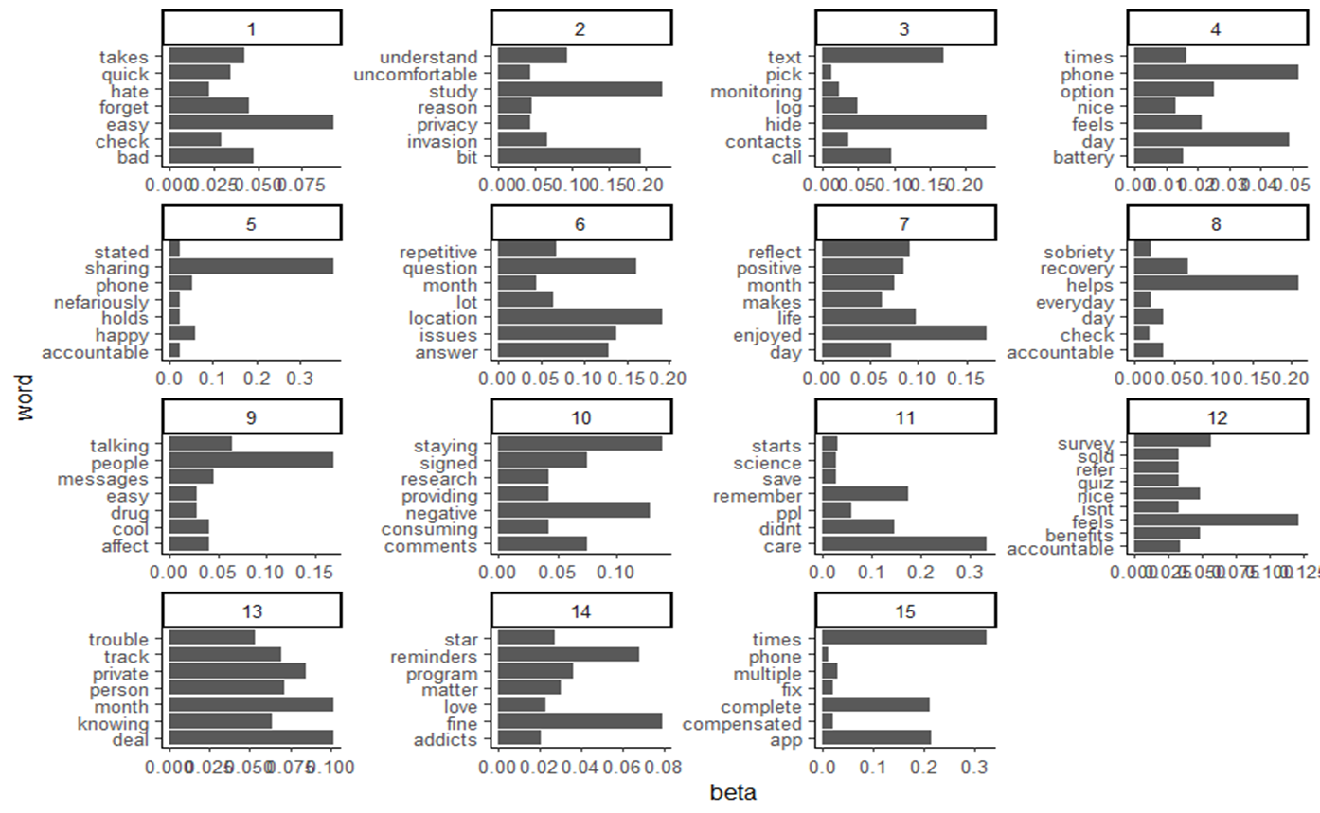
Comments
“It’s a bit of an invasion of privacy but I understand why its needed for the study.”
“Its a bit uncomfortable sharing my phone logs, but I am aware its only for the study.”
“I understand its part of how this works, and I believe the study runners when they say they don't use it for any reason other than to help the creation of the app.”
Hispanic participants
White participants
Notes:
Topic 2 – with words like “understand”, “study”, “privacy”, and “invasion” were participants’ reflection on the personal sensing where they stated they were uncomfortable, but knew it was for the study, so they understood.
This topic was more commonly endorsed by Hispanic participants than it was by White participants.

Slide 26
Comments
“Holds me accountable for the place I have gone.”
“I don't mind sharing the location as long as it's not used nefariously.”
“I don't mind sharing my GPS I'm not doing anything I'm not supposed to, so it does not bother me and as I stated before I understand this is a study for opioid addiction, and I'm happy to be part of the solution now.”
Black participants
White participants
Notes:
For example, words such as “nefariously”, “happy”, and “accountable” demonstrates how participants don’t mind sharing their geolocation as it provides benefits and they trust the study runners.
This topic was less commonly endorsed by Black participants than it was by White participants.

Slide 27
Comments
“I also enjoy the monthly update because it helps me take inventory over the month about who I've been talking to and how they affect me.”
“Helps me be mindful of the people, places, and things and their impact.”
“Honestly takes 10 seconds and its super easy. I've noticed some people in the chats actually get high risk location warnings, which is cool, hope this works out for some people. even if it saves only one life.”
Black participants
White participants
Notes:
Topic 9 – with words like “talking”, “easy”, “cool”, and “affect” showcases participants’ feelings about the monthly updates and the benefits it provides them.
This topic was more commonly endorsed by Black participants than it was by White participants.

Slide 28
Comments
“I don't really care, willing to do it for science.”
“I don't even remember to think or care about sharing my GPS data.”
“I don't mind because I know you all are trying to save drug addicts lives thank you star.”
Hispanic participants
Black participants
White participants
Notes:
Words such as “science”, “save”, and “care” noted that this study contributes to something bigger and will one day save people, so they aren’t concerned with using passive sensing measures.
This topic was less commonly endorsed by both Hispanic and Black participants than it was by White participants. which aligns with our finding from the thematic analysis that showed Black and Hispanic participants more commonly endorsed negative comments for message content and geolocation.

Slide 29
Comments
“Lots of these are really personal and private. But knowing there are things that could potentially be used to get me in trouble in some way or another does scare me some.”
“Don't like being tracked.”
“Once again, I'm a very private person.”
Black participants
White participants
Notes:
And finally, words like “trouble”, “private”, and “people” showed that people had concerns about tracking both for themselves and for the people they were communicating with.
This topic was more commonly endorsed by Black participants than it was by White participants.
These findings align with our findings from the thematic analysis that showed Black and Hispanic participants did not comment positively about geolocation and message content as often as White participants.

Slide 30
Comments
“I am grateful for the opportunity I have given to help fine tune an application I can see having real world positive consequences for people who struggle with addiction.”
“I love this program I appreciate it.”
“I’m ok with it if it may can help someone else in any way because research on this matter.”
Black participants
White participants
Notes:
Topic 14 – with words such as “program”, “matter”, “love” and “addicts” noted their appreciation for participating in this program that will help so many people.
This topic was more commonly endorsed by Black participants than it was by White participants.

Slide 31

Implications
On average, participants found these methods to be acceptable, saw benefits from using them, and reported positively.
There were differences in acceptability of personal sensing types across racial/ethnic groups.
Notes:
So, what did these results tell us?
On average, participants found these methods to be acceptable and saw benefits from using them.
However, its important to acknowledge that not all participants felt this way. There were differences in acceptability of personal sensing types, specifically monthly updates from Hispanic participants and geolocation and message content from Black participants.

Slide 32
Future Directions - Research
Closely examine race/ethnicity differences
Understand them so we can work towards mitigating them.
Cross-compare affect and themes
Look at each theme to see if there were more positive or negative comments.
Neutral/mixed affect
Separate this category and better distinguish “mixed affect”.
End-of-study survey
Gauging participants’ reactions after using personal sensing for a full year.
Notes:
The first thing we want to do is understand these differences exist and what we can do to mitigate them. Some ways we can gain a better understanding would be to first address some limitations of the current project. We would want to…
Look at the amount of positive and negative comments within each theme to better understand participants’ feelings. For example, with the theme acceptability, were more participants saying “yes, I love this app!” or “no, I don’t like this app”.
Separate mixed from the neutral/mixed affect category and better disseminate the tone of participants’ comments.
Administer an end-of-study survey to the participants. While the survey at the ¾ month mark provided insight, I’d be interested to see how participants felt after using these methods for a full a year.

Slide 33

Future Directions – Real World Applications
Input into algorithms to predict lapses
Help people better understand what causes them to and when they’ll use next.
An app to monitor recovery process
Keeping track 24/7 from anywhere in the world.
Notes:
In the future,
We’d like to input what we’ve learned about people into algorithms to predict lapses so that people can better understand what increases their desire to use and when they’ll use next.
And lastly, we’re hopeful this research will lead to the development of an app people can use to monitor their recovery 24/7 from anywhere in the world.

Slide 34
Thank you!
I’d like to acknowledge Kendra Wyant, Dr. John Curtin, and the Addiction Research Center for their mentorship and support this summer, Dr. Brad Postle and Sarah Sant’Ana for being great advisors, the opportunity to learn from the PREP Faculty and mentors, and the amazing cohort I got to spend time with.
Notes:
I’d like to acknowledge Kendra Wyant, Dr. John Curtin, and the Addiction Research Center for their mentorship and support this summer, Dr. Brad Postle and Sarah Sant’Ana for being great advisors, the opportunity to learn from the PREP Faculty and mentors, and the amazing cohort I got to spend time with.

Slide 35
Questions?
oliviac03@vt.edu

Slide 36




Location
Urban populations’ distrust of police has led to people not intervening when someone is experiencing and overdose.
Rural populations’ limited access to treatment has led to an increase in overdose-related deaths.
Marcu et al. 2019; Lister et al. 2020
Race/Ethnicity
African Americans and other historically marginalized groups are less likely to receive treatment for opioid use disorder.
Barnett et al. 2023
Gender
Women face more stigma living with opioid use disorder and have different needs than men when it comes to treatment options.
Di Paola et al. 2022
Socioeconomic Status
Individuals of a lower SES are less likely to be treated or be referred for treatment for opioid use disorder.
Siddiqui and Urman, 2022
Notes:
But recovery and treatment do not look the same for everyone. There are demographic differences to consider when developing treatment methods.
Location (urban, suburban, rural) plays a huge factor in acceptability of treatment. In urban populations, such as Philadelphia, PA, distrust of the police may result in bystanders not intervening when someone is experiencing an overdose. This may lead them to distrust personal sensing methods such as GPS and SMS tracking. In rural areas, limited availability of medication treatment has led to overdose-related deaths.
In terms of race, African Americans and other historically marginalized groups are less likely than White people to receive treatment for opioid use disorder.
As for gender, women face more stigma living with opioid use disorder, lessening their desire to seek treatment.
And lastly, individuals of a lower SES are less likely to be treated or be referred for treatment for opioid use disorder.
To ensure we are not increasing treatment access disparities it is important to examine acceptability ratings overall and separately by important demographic characteristics of the sample.

Slide 37
Clinical Characteristics
N = 200
Notes:
We used the DSM 5 criteria for measuring opioid use disorder. The scale ranges from 0-11. A score of 6 or higher indicates severe OUD. 96% of our sample scores a 6 or higher, with 60% of our sample endorsing all 11 DSM-5 symptom criteria.
86% of participants report taking opioid medication (like suboxone or methadone) daily
And 57% of our sample reported experiencing at least one overdose over their life.

Slide 38
Thematic Analysis – Additional Themes
Theme | Comment | % of comments, (n)
Getting in trouble | “Idk. Don't wish to get anyone in trouble.” | 0.77%, (5)
Data already tracked | “Everyone is being tracked.” | 1.08%, (7)
Research/Study/Science | “Nothing to say its part of the program its not hard to do.” | 5.87%, (38)
Honesty | “Nothing to hide here.” | 4.79%, (31)
Notes:
Seventh is getting in trouble, some participants expressed concerns about the data they share getting themselves or others in trouble.
The eighth theme was data already tracked. Some participants expressed little concern about GPS and SMS data being shared as many other apps already track that.
Next is research/study/science, where participants accepted as methods as they had already agreed to be in the study.
The final theme was honesty. Participants would note that there was nothing they were concerned about us seeing.

Slide 39
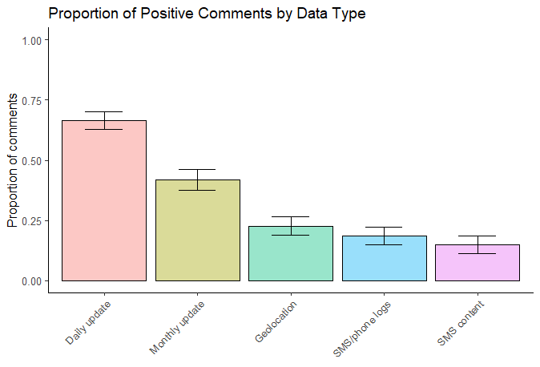
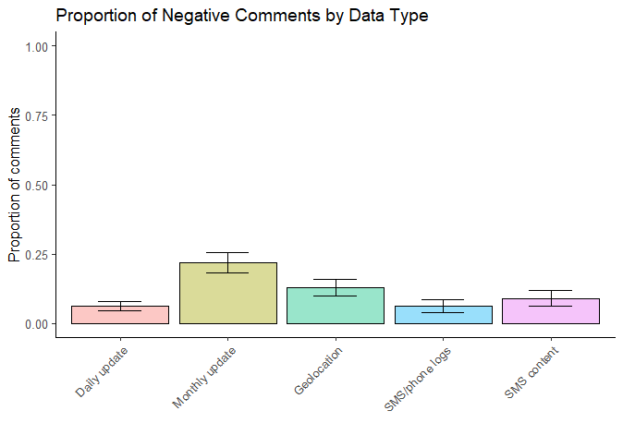
Proportion of Comments by Data Type - Affect
Notes:
These graphs show the proportion of affect conveyed by participants across data types. Most participants reported positively about the data types.

Slide 40
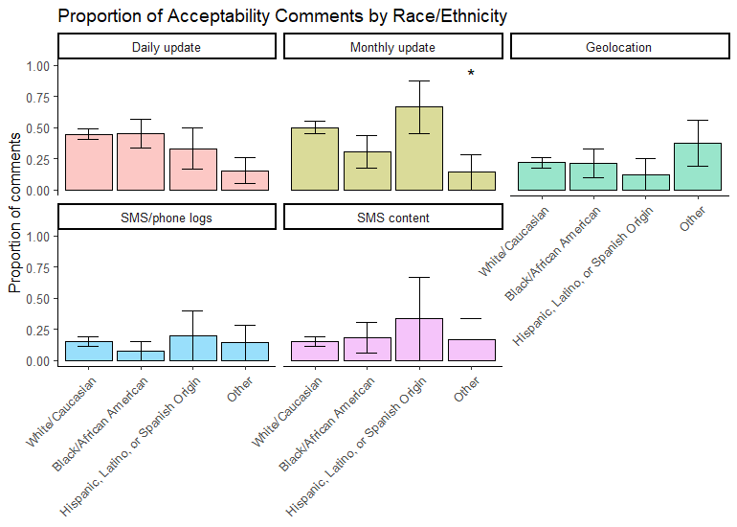
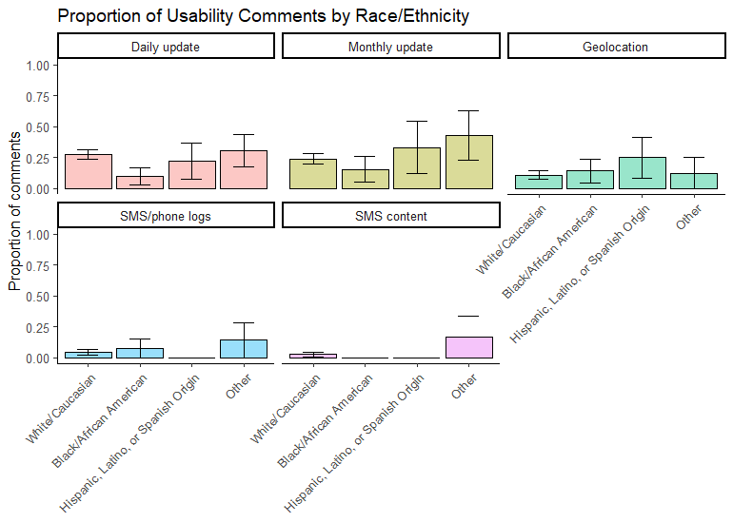
Demographic Differences in Theme - Race

Slide 41
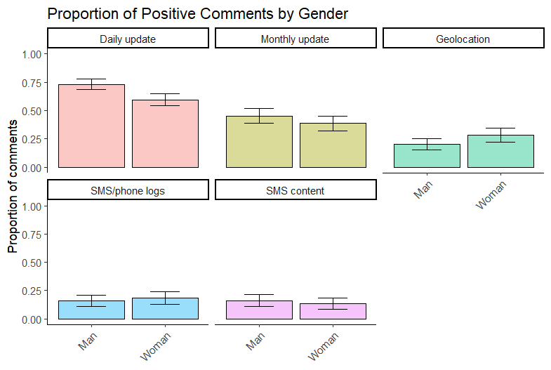
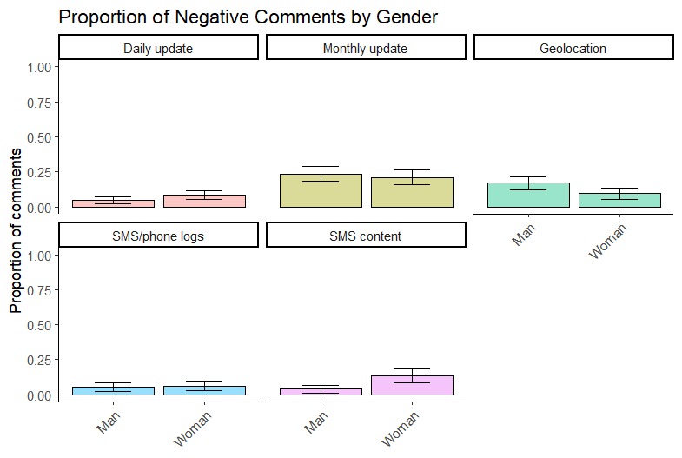
Demographic Differences in Themes - Gender
Notes:
We saw fairly consistent patterns for Women and Men across themes and affect.

Slide 42
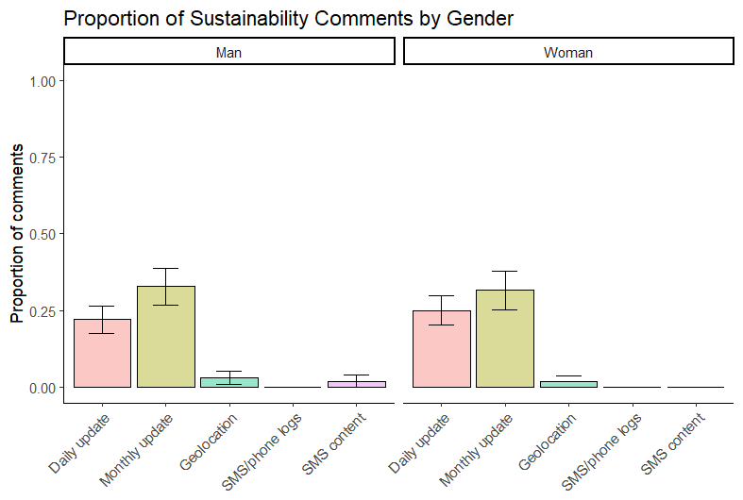
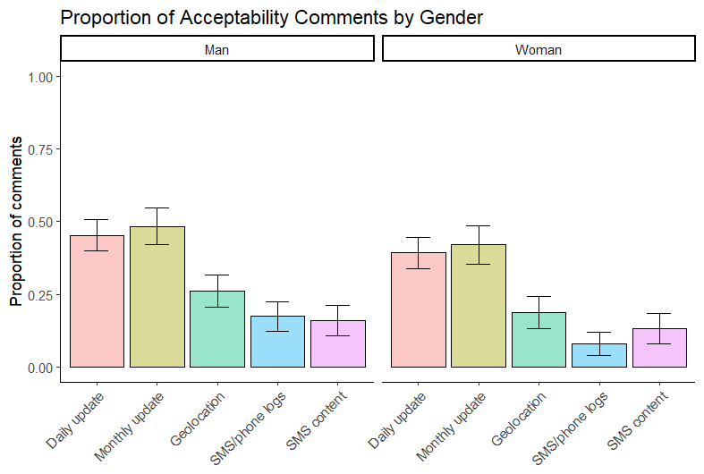
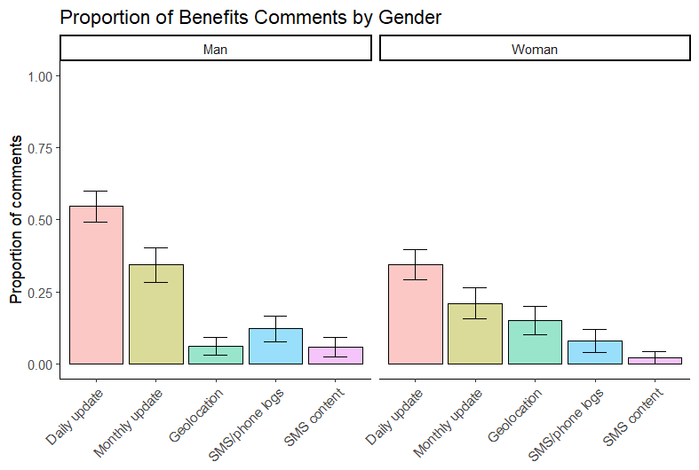
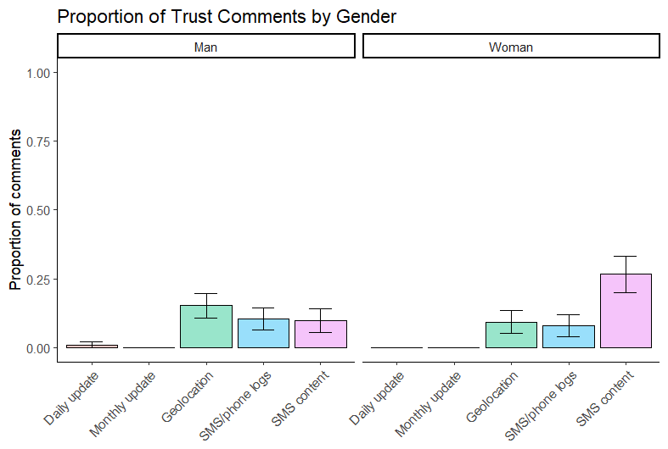
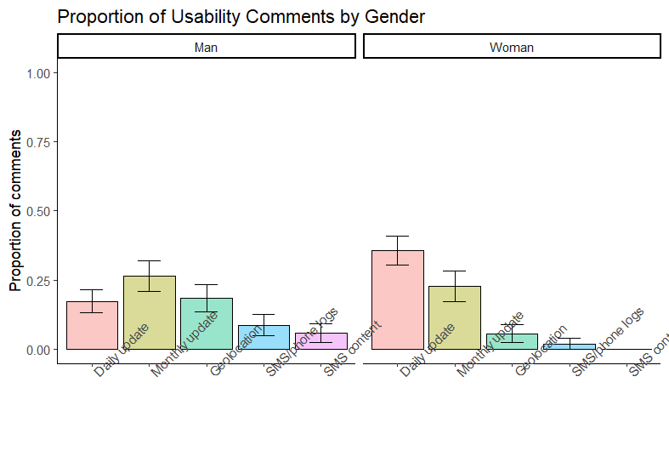
Demographic Differences in Themes - Gender

Slide 43
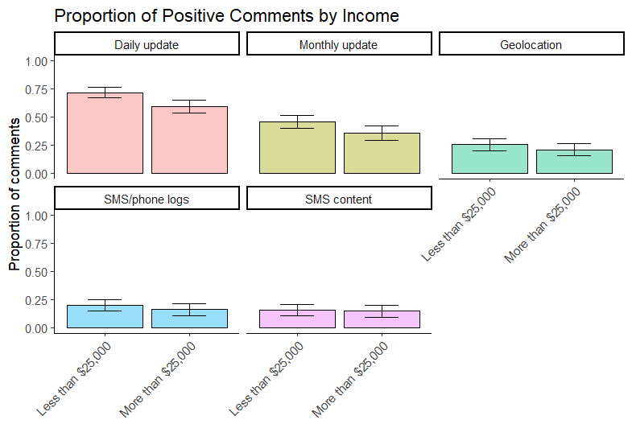
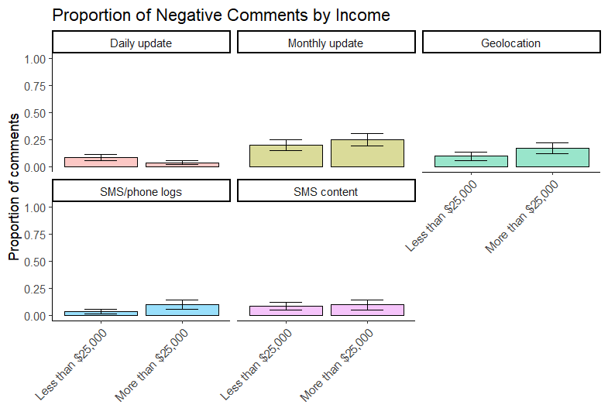
Demographic Differences in Themes - Income
Notes:
We also saw relatively consistent patterns across themes and affect for income.

Slide 44
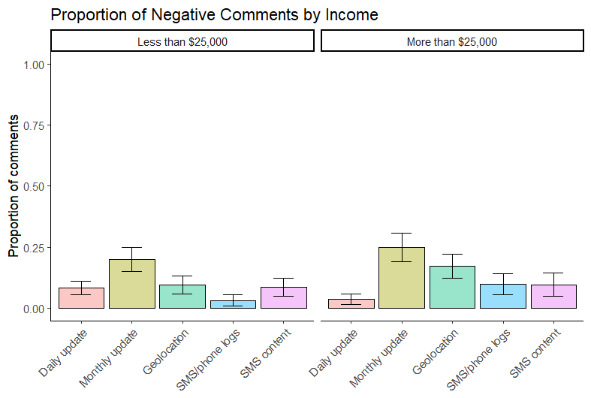
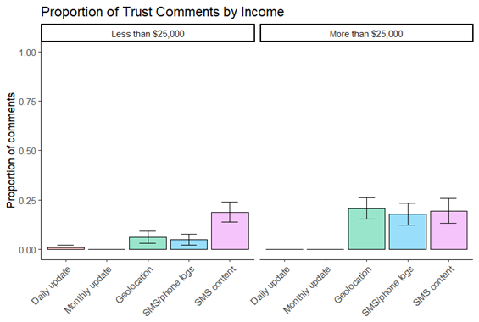
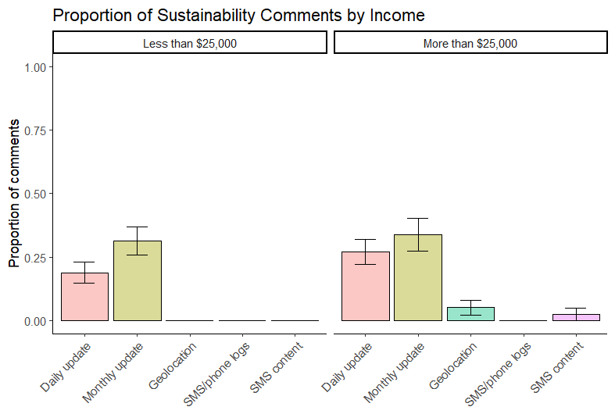
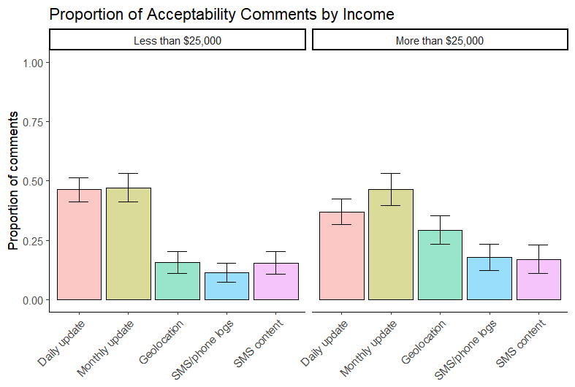
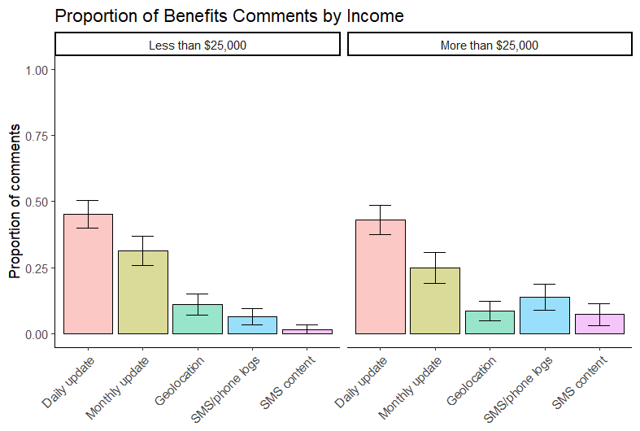
Demographic Differences in Themes - Income

Slide 45
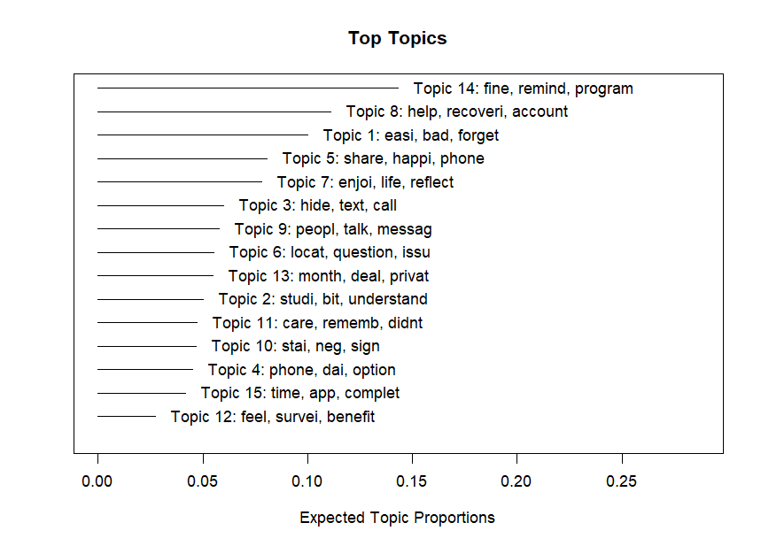
Proportion of Topics
Notes:
We used these expected proportions to see if there are differences between different demographic groups

Slide 46
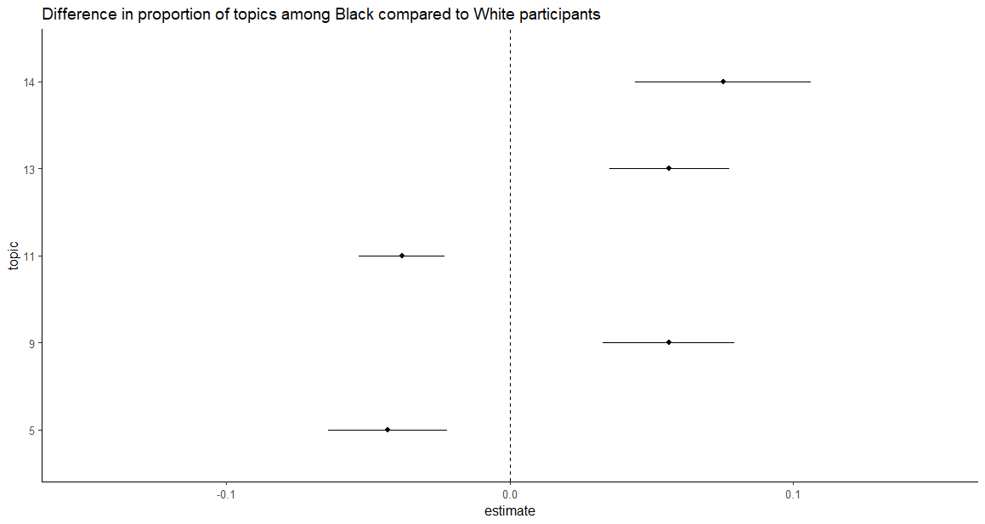
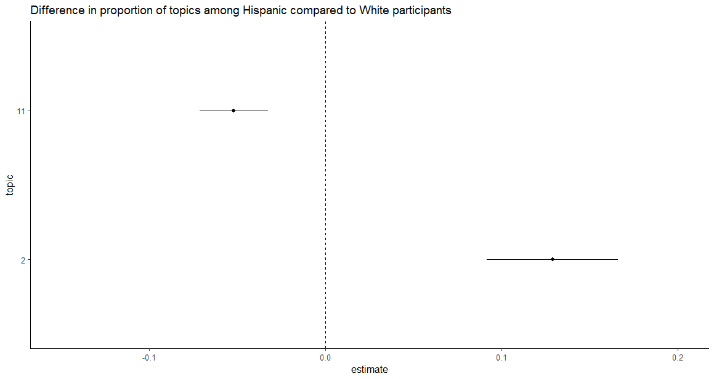
Demographic Differences in Themes - Race
Notes:
White participants significantly differed in the proportion of comments for 5 topics compared to Black participants. Black participants more commonly endorsed topics 9, 13, and 14, but didn’t endorse topics 5 and 11 as often as White participants.
White participants significantly differed in the proportion of comments for 2 topics compared to Hispanic participants. Hispanic participants more commonly endorsed topic 2, but like Black participants, didn’t endorse topic 11 as often as White participants.

Slide 47



Individual
Stigma
Lack of social support
Cost of care
McLean, Murphy, and Kruis 2024
Notes:
There are many barriers to individuals with opioid use disorder seeking treatment. Individual barriers include stigma, cost of care, and lack of social support. Substance use disorders are not viewed as mental health conditions but are instead viewed as “the individual’s own fault/problem”. Due to this, individuals with OUD fear reaching out for treatment as their self-mage has been demonized.
Furthermore, social support has been found to be incredibly important in helping individuals with their recovery. Encouragement and support are necessary to overcome the constant challenges associated with recovery. Without it, individuals may struggle to feel seen, not have access to reliable housing and/or transportation or be forced to continue with bad relationships that encourage use or relapse.
And of course, cost of care is a large concern for many individuals. Low-income participants are unable to afford costly co-pays and those on public insurance can’t access certain facilities or enjoy longer, medically-justified treatment stays.

Slide 48
Individual
Stigma
Lack of social support
Cost of care
Provider/Institutional
Low treatment availability in rural areas
Low variety of treatment options
System navigation
McLean, Murphy, and Kruis 2024
Notes:
Provider/institutional barriers include low treatment availability in rural areas, low variety of treatment options, and system navigation.
Some counties in rural areas have no providers to aid individuals with opioid use disorder seeking treatment. And if treatment is available in an area, there isn’t always sufficient choice or access to immediate treatment slots.
Individuals with substance use disorders is a growing population. Due to this, psychiatric care and counseling are becoming harder to access due to lack of providers, long wait times, or geographic barriers. In addition, provider burnout has become a major issue, limiting the capacity of providers and the care they can offer.
System navigation can be difficult, especially for those with no social support or those of lower SES. Individuals feel providers fail to collaborate with patients, making treatment that much harder to access and less desirable.

Slide 49
Individual
Stigma
Lack of social support
Cost of care
Provider/Institutional
Low treatment availability in rural areas
Low variety of treatment options
System navigation
Societal/Systematic
Laws surrounding treatment
Flawed justice system
Lack of education about addiction
McLean, Murphy, and Kruis 2024
Notes:
Societal/systematic barriers include laws surrounding treatment, a flawed justice system, and lack of education about addiction.
There are multiple laws and policies in place that make treatment harder to access. One being that methadone maintenance is so tightly regulated that it is difficult to keep patients in care. In addition, eligibility for public insurance undermines treatment plans as individuals lose funding for their treatment plans once they begin to make a certain income. This loss of funding greatly discourages them from continuing treatment.
Our justice system is incredibly flawed in helping those with substance use problems. The “War on Drugs” has reoriented all drug-related service towards punishment rather than treatment. This causes people to fear reaching out as they may be thrown in prison, which may exacerbate their problems.
Stigma, which was discussed as an individual barrier, stems from a lack of education about the disease model of addiction. If society better understood addiction, they may be more likely to help those with substance use problems and support treatment programs and initiatives.

